Slide 1
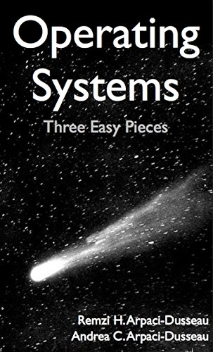
Computer Operating Systems BLG 312E Week-6
Prof. Dr. Kemal Bıçakcı

Slide 2
Review of Last Week

Slide 3
Review Question
In a paging system, virtual addresses are 48-bit long and physical addresses are 32-bit long. How many pages are there in this system?
a) 2¹⁶
b) 2³²
c) 2⁴⁸
d) Cannot be computed from the given data.

Slide 4
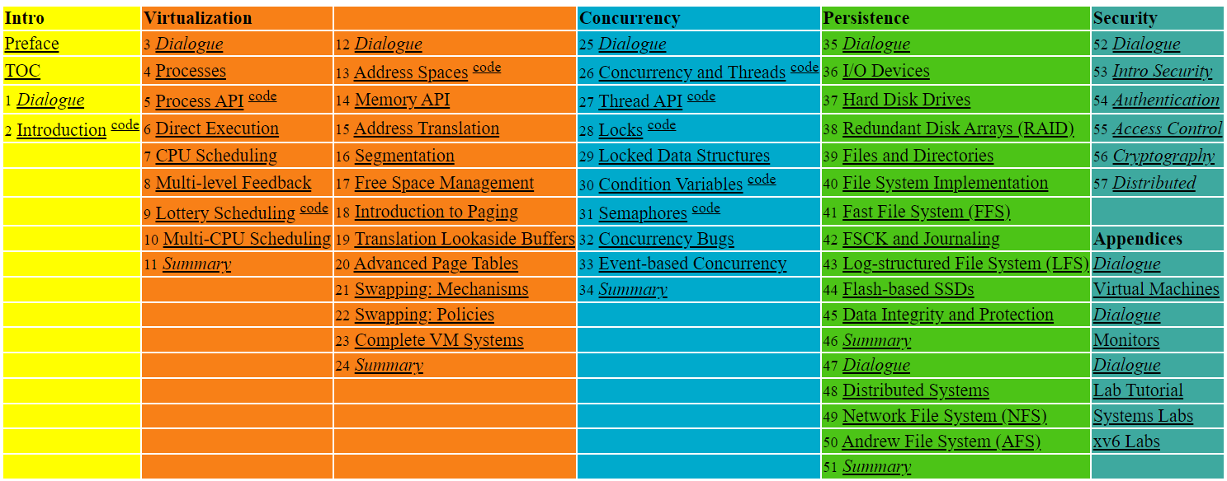

Slide 5
19. Translation Lookaside Buffers
Operating System: Three Easy Pieces

Slide 6
TLB (Translation Lookaside Buffer)
Part of the chip’s memory-management unit (MMU).
A hardware cache of popular virtual-to-physical address translation.
TLB
Lookup
MMU
Logical
Address
TLB Hit
Physical
Address
TLB
popular v to p
CPU
Page 0
Page 1
Page 2
TLB Miss
…
Page Table
all v to p entries
Page n
Physical Memory
Address Translation with MMU

Slide 7
TLB Basic Algorithm
1: VPN = (VirtualAddress & VPN_MASK ) >> SHIFT
2: (Success , TlbEntry) = TLB_Lookup(VPN)
3: if(Success == True){ // TLB Hit
4: if(CanAccess(TlbEntry.ProtectBit) == True ){
5: offset = VirtualAddress & OFFSET_MASK
6: PhysAddr = (TlbEntry.PFN << SHIFT) | Offset
7: AccessMemory(PhysAddr)
8: }else RaiseException(PROTECTION_ERROR)
(1 lines) extract the virtual page number (VPN).
(2 lines) check if the TLB holds the translation for this VPN.
(5-8 lines) extract the page frame number from the relevant TLB entry, and form the desired physical address and access memory.

Slide 8
TLB Basic Algorithm (Cont.)
11: }else{ //TLB Miss
12: PTEAddr = PTBR + (VPN * sizeof(PTE))
13: PTE = AccessMemory(PTEAddr)
14: (…)
15: }else{
16: TLB_Insert(VPN, PTE.PFN, PTE.ProtectBits)
17: RetryInstruction()
18: }
19:}
(11-12 lines) The hardware accesses the page table to find the translation.
(16 lines) updates the TLB with the translation.

Slide 9
Example: Accessing An Array
How a TLB can improve performance:
OFFSET 00 04 08 12 16
VPN = 00
VPN = 01
VPN = 03
VPN = 04
VPN = 05
VPN = 06 |  | a[0] | a[1] | a[2]
VPN = 07 | a[3] | a[4] | a[5] | a[6]
VPN = 08 | a[7] | a[8] | a[9]
VPN = 09
VPN = 10
VPN = 11
VPN = 12
VPN = 13
VPN = 14
VPN = 15
0: int sum = 0 ;
1: for( i=0; i<10; i++){
2: sum+=a[i];
3: }
The TLB improves performance
due to spatial locality
3 misses and 7 hits.
Thus TLB hit rate is 70%.

Slide 10
Locality
Temporal Locality
An instruction or data item that has been recently accessed will likely be re-accessed soon in the future.
Spatial Locality
If a program accesses memory at address x, it will likely soon access memory near x.
Page 6
…
Page 1
Page 7
Page 2
Page 3
Page 4
Page 5
Page n
Virtual Memory
Page 1
Page 2
Page 3
Page 4
Page 5
…
Page n
Virtual Memory

Slide 11
Who Handles The TLB Miss?
On CISC, hardware handles the TLB miss entirely.
Hardware-managed TLB:
The hardware has to know exactly where the page tables are located in memory.
The hardware would “walk” the page table, find the correct page-table entry and extract the desired translation, update and retry instruction.

Slide 12
Who Handles The TLB Miss? (Cont.)
RISC has what is known as a software-managed TLB.
On a TLB miss, the hardware raises exception (trap handler).
Trap handler: code within the OS that is written with the purpose of handling TLB miss.

Slide 13
TLB Control Flow algorithm (OS Handled)
1: VPN = (VirtualAddress & VPN_MASK) >> SHIFT
2: (Success, TlbEntry) = TLB_Lookup(VPN)
3: if (Success == True) // TLB Hit
4: if (CanAccess(TlbEntry.ProtectBits) == True)
5: Offset = VirtualAddress & OFFSET_MASK
6: PhysAddr = (TlbEntry.PFN << SHIFT) | Offset
7: Register = AccessMemory(PhysAddr)
8: else
9: RaiseException(PROTECTION_FAULT)
10: else // TLB Miss
11: RaiseException(TLB_MISS)

Slide 14
TLB entry
TLB is managed by Full Associative method.
A typical TLB might have 32,64, or 128 entries.
Hardware searches the entire TLB in parallel to find the desired translation.
other bits: valid bits, protection bits, address-space identifier, dirty bit
VPN
PFN
other bits
Typical TLB entry

Slide 15
TLB Issue: Context Switching
Page 0
Page 1
Process A
Page 2
Insert TLB Entry
access VPN10
…
Page n
TLB Table
Virtual Memory
VPN | PFN | valid | prot
10 | 100 | 1 | rwx
- | - | - | -
- | - | - | -
- | - | - | -
Page 0
Process B
Page 1
Page 2
…
Page n
Virtual Memory

Slide 16
TLB Issue: Context Switching
Page 0
Page 1
Process A
Page 2
…
Page n
TLB Table
Virtual Memory
VPN | PFN | valid | prot
10 | 100 | 1 | rwx
- | - | - | -
10 | 170 | 1 | rwx
- | - | - | -
Context
Switching
Page 0
Process B
access VPN10
Page 1
Page 2
Insert TLB Entry
…
Page n
Virtual Memory

Slide 17
TLB Issue: Context Switching
Page 0
Page 1
Process A
Page 2
…
Page n
TLB Table
Virtual Memory
VPN | PFN | valid | prot
10 | 100 | 1 | rwx
- | - | - | -
10 | 170 | 1 | rwx
- | - | - | -
Page 0
Process B
Page 1
Page 2
…
Can’t distinguish which entry is
meant for which process
Page n
Virtual Memory

Slide 18
To Solve the Problem
Provide an address space identifier (ASID) field in the TLB.
Page 0
Page 1
Process A
Page 2
…
TLB Table
Page n
VPN | PFN | valid | prot | ASID
10 | 100 | 1 | rwx | 1
- | - | - | - | -
10 | 170 | 1 | rwx | 2
- | - | - | - | -
Virtual Memory
Page 0
Process B
Page 1
Page 2
…
Page n
Virtual Memory

Slide 19
Another Case: Sharing
Two processes share a page.
Process 1 is sharing physical page 101 with Process 2.
P1 maps this page into the 10th page of its address space.
P2 maps this page to the 50th page of its address space.
VPN | PFN | valid | prot | ASID
10 | 101 | 1 | rwx | 1
- | - | - | - | -
50 | 101 | 1 | rwx | 2
- | - | - | - | -
Sharing of pages is useful as it reduces the number of physical pages in use.

Slide 20
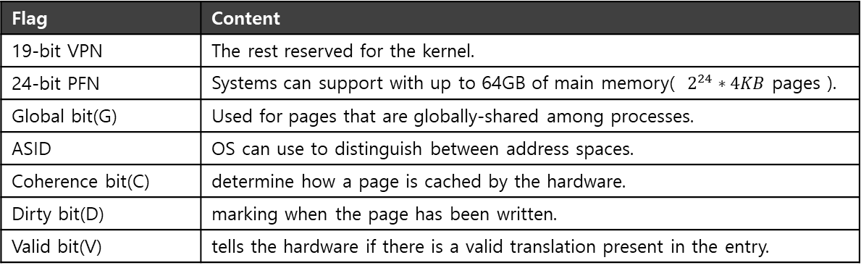
A Real TLB Entry
All 64 bits of this TLB entry (example of MIPS R4000)
0 1 2 3 4 5 6 7 8 9
10 11 … 19 … 31
VPN
G
ASID
PFN
C
D
V
Flag | Content
19-bit VPN | The rest reserved for the kernel.
24-bit PFN | Systems can support with up to 64GB of main memory( $2^{24}∗4KB$ pages ).
Global bit(G) | Used for pages that are globally-shared among processes.
ASID | OS can use to distinguish between address spaces.
Coherence bit(C) | determine how a page is cached by the hardware.
Dirty bit(D) | marking when the page has been written.
Valid bit(V) | tells the hardware if there is a valid translation present in the entry.

Slide 21
20. Paging: Smaller Tables
Operating System: Three Easy Pieces

Slide 22

Paging: Linear Tables
We usually have one page table for every process in the system.
Assume that 32-bit address space with 4KB pages and 4-byte page-table entry.
4B
entry
4KB
PF 0
entry
entry
PF 1
…
PF 2
…
entry
PF n
Page Table of
Process A
Physical Memory
Page table size = $\frac{2^{32}}{2^{12}}∗4Byte=4MByte$
Page tables are too big and thus consume too much memory.
Notes:
여백 감소 페이지 사이의 간격을 없애기.

Slide 23

Paging: Smaller Tables
Page tables are too big and thus consume too much memory.
Assume that 32-bit address space with 16KB pages and 4-byte page-table entry.
4B
entry
16KB
PF 0
entry
entry
PF 1
…
PF 2
…
entry
PF n
Page Table of
Process A
Physical Memory
$\frac{2^{32}}{2^{16}}∗4=0,25MB$ per page table
Big pages lead to internal fragmentation.
Notes:
여백 감소 페이지 사이의 간격을 없애기.

Slide 24
Problem
Page table is using the physical memory for all the pages in the address space of process.
Physical Memory
Virtual Address
Space
0
1
2
3
4
5
6
7
8
9
10
11
12
13
14
15
16
17
18
19
20
21
22
23
24
25
PFN | valid | prot | present | dirty
10 | 1 | r-x | 1 | 0
- | 0 | - | - | -
- | 0 | - | - | -
- | 0 | - | - | -
15 | 1 | rw- | 1 | 1
… | … | … | … | …
- | 0 | - | - | -
3 | 1 | rw- | 1 | 1
23 | 1 | rw- | 1 | 1
code
 | 0
 | 1
 | 2
 | 3
 | 4
 | 5
 | 12
 | 13
 | 14
 | 15
Allocate
heap
A Page Table For 16KB Address Space
stack
A 16KB Address Space with 1KB Pages

Slide 25
Problem
Most of the page table is unused, full of invalid entries.
Physical Memory
Virtual Address
Space
0
1
2
3
4
5
6
7
8
9
10
11
12
13
14
15
16
17
18
19
20
21
22
23
24
25
PFN | valid | prot | present | dirty
10 | 1 | r-x | 1 | 0
- | 0 | - | - | -
- | 0 | - | - | -
- | 0 | - | - | -
15 | 1 | rw- | 1 | 1
… | … | … | … | …
- | 0 | - | - | -
3 | 1 | rw- | 1 | 1
23 | 1 | rw- | 1 | 1
code
 | 0
 | 1
 | 2
 | 3
 | 4
 | 5
 | 12
 | 13
 | 14
 | 15
Allocate
heap
A Page Table For 16KB Address Space
stack
A 16KB Address Space with 1KB Pages

Slide 26
Hybrid Approach: Paging and Segments
In order to reduce the memory overhead of page tables:
Using base not to point to the segment itself but rather to hold the physical address of the page table of that segment.
The bounds register is used to indicate the end of the page table.

Slide 27
Simple Example of Hybrid Approach
Each process has three page tables associated with it.
When process is running, the base register for each of these segments contains the physical address of a linear page table for that segment.
31 30 29 28 27 26 25 24 23 22 21 20 19 18 17 16 15 14 13 12 11 10 9 8 7 6 5 4 3 2 1 0
Seg
VPN
Offset
32-bit Virtual address space with 4KB pages
Seg value | Content
00 | unused segment
01 | code
10 | heap
11 | stack

Slide 28
TLB miss on Hybrid Approach
The hardware learns physical address of page table.
The hardware uses the segment bits (SN) to determine which base and bounds pair to use.
The hardware then takes the physical address therein and combines it with the VPN to form the address of the page table entry (PTE).
01: SN = (VirtualAddress & SEG_MASK) >> SN_SHIFT
02: VPN = (VirtualAddress & VPN_MASK) >> VPN_SHIFT
03: AddressOfPTE = Base[SN] + (VPN * sizeof(PTE))

Slide 29
Problem of Hybrid Approach
Hybrid Approach is not without problems.
If we have a large but sparsely-used heap, we can still end up with a lot of page table waste.
Causing external fragmentation to arise again.

Slide 30
Multi-level Page Tables
Turns the linear page table into something like a tree.
Chop up the page table into page-sized units.
If an entire page of page-table entries is invalid, don’t allocate that page of the page table at all.
To track whether a page of the page table is valid, use a new structure, called page directory.

Slide 31
Multi-level Page Tables: Page Directory
Linear Page Table
PTBR
201
Multi-level Page Table
valid
prot
PFN
PDBR
200
1 | rx | 12
1 | rx | 13
0 | - | -
1 | rw | 100
0
0
0
0
0
0
0
0
0 | - | -
0 | - | -
1 | rw | 86
1 | rw | 15
PFN201
valid
PFN
valid
prot
PFN
1 | 201
0 | -
0 | -
1 | 203
1 | rx | 12
1 | rx | 13
0 | - | -
1 | rw | 100
PFN200
PFN201
PFN202
The Page Directory
[Page 1 of PT:Not Allocated]
PFN202
[Page 2 of PT: Not Allocated]
0 | - | -
0 | - | -
1 | rw | 86
1 | rw | 15
PFN204
PFN204
Linear (Left) And Multi-Level (Right) Page Tables

Slide 32
Multi-level Page Tables: Page directory entries
The page directory contains one entry per page of the page table.
It consists of a number of page directory entries (PDE).
PDE has a valid bit and page frame number (PFN).

Slide 33
Multi-level Page Tables: Advantage & Disadvantage
Advantage
Only allocates page-table space in proportion to the amount of address space you are using.
The OS can grab the next free page when it needs to allocate or grow a page table.
Disadvantage
Multi-level table is a small example of a time-space trade-off.
Complexity.

Slide 34
Multi-level Page Table: Level of indirection
A multi-level structure can adjust level of indirection through use of the page directory.
Indirection place page-table pages wherever we would like in physical memory.

Slide 35
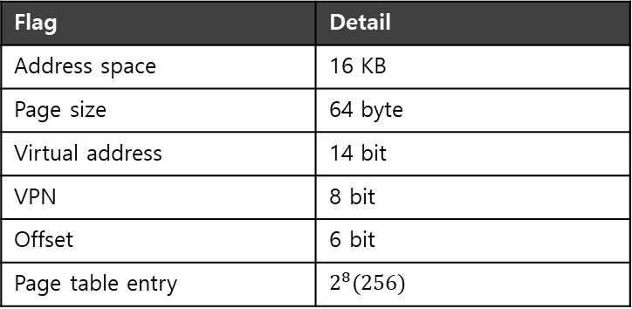
A Detailed Multi-Level Example
To understand the idea behind multi-level page tables better, let’s see an example.
0000 0000
code
code
(free)
(free)
heap
heap
(free)
(free)
stack
stack
0000 0001
...
Flag | Detail
Address space | 16 KB
Page size | 64 byte
Virtual address | 14 bit
VPN | 8 bit
Offset | 6 bit
Page table entry | $$2^{8}(256)$$
1111 1111
A 16-KB Address Space With 64-byte Pages
13 | 12 | 11 | 10 | 9 | 8 | 7 | 6 | 5 | 4 | 3 | 2 | 1 | 0
VPN
Offset

Slide 36
A Detailed Multi-Level Example: Page Directory Index
The page directory needs one entry per page of the page table
it has 16 entries.
The page-directory entry is invalid → Raise an exception (The access is invalid)
Page Directory Index
13 | 12 | 11 | 10 | 9 | 8 | 7 | 6 | 5 | 4 | 3 | 2 | 1 | 0
VPN
Offset
14-bits Virtual address

Slide 37
A Detailed Multi-Level Example: Page Table Index
The PDE is valid, we have more work to do.
To fetch the page table entry (PTE) from the page of the page table pointed to by this page-directory entry.
This page-table index can then be used to index into the page table itself.
Page Directory Index
Page Table Index
13 | 12 | 11 | 10 | 9 | 8 | 7 | 6 | 5 | 4 | 3 | 2 | 1 | 0
VPN
Offset
14-bits Virtual address

Slide 38
More than Two Level
In some cases, a deeper tree is possible.
30 29 28 27 26 25 24 23 22 21 20 19 18 17 16 15 14 13 12 11 10 9 8 7 6 5 4 3 2 1 0
VPN
offset
Flag | Detail
Virtual address | 30 bit
Page size | 512 byte
VPN | 21 bit
Offset | 9 bit

Slide 39

More than Two Level : Page Table Index
In some cases, a deeper tree is possible.
30 29 28 27 26 25 24 23 22 21 20 19 18 17 16 15 14 13 12 11 10 9 8 7 6 5 4 3 2 1 0
Page Directory Index
Page Table Index
VPN
offset
Flag | Detail
Virtual address | 30 bit
Page size | 512 byte
VPN | 21 bit
Offset | 9 bit
Page entry per page | 128 PTEs
$$\log_{2}{128=7}$$

Slide 40
More than Two Level : Page Directory
If our page directory has $2^{14}$entries, it spans not one page but 128.
To remedy this problem, we build a further level of the tree, by splitting the page directory itself into multiple pages of the page directory.
30 29 28 27 26 25 24 23 22 21 20 19 18 17 16 15 14 13 12 11 10 9 8 7 6 5 4 3 2 1 0
PD Index 0
PD Index 1
Page Table Index
VPN
offset

Slide 41
Multi-level Page Table Control Flow
01: VPN = (VirtualAddress & VPN_MASK) >> SHIFT
02: (Success,TlbEntry) = TLB_Lookup(VPN)
03: if(Success == True) //TLB Hit
04: if(CanAccess(TlbEntry.ProtectBits) == True)
05: Offset = VirtualAddress & OFFSET_MASK
06: PhysAddr = (TlbEntry.PFN << SHIFT) | Offset
07: Register = AccessMemory(PhysAddr)
08: else RaiseException(PROTECTION_FAULT);
09: else // perform the full multi-level lookup
(1 lines) extract the virtual page number(VPN)
(2 lines) check if the TLB holds the transalation for this VPN
(5-8 lines) extract the page frame number from the relevant TLB entry, and form the desired physical address and access memory

Slide 42
Multi-level Page Table Control Flow
11: else
12: PDIndex = (VPN & PD_MASK) >> PD_SHIFT
13: PDEAddr = PDBR + (PDIndex * sizeof(PDE))
14: PDE = AccessMemory(PDEAddr)
15: if(PDE.Valid == False)
16: RaiseException(SEGMENTATION_FAULT)
17: else // PDE is Valid: now fetch PTE from PT
(11 lines) extract the Page Directory Index(PDIndex)
(13 lines) get Page Directory Entry(PDE)
(15-17 lines) Check PDE valid flag. If valid flag is true, fetch Page Table entry from Page Table

Slide 43
The Translation Process: Remember the TLB
18: PTIndex = (VPN & PT_MASK) >> PT_SHIFT
19: PTEAddr = (PDE.PFN << SHIFT) + (PTIndex * sizeof(PTE))
20: PTE = AccessMemory(PTEAddr)
21: if(PTE.Valid == False)
22: RaiseException(SEGMENTATION_FAULT)
23: else if(CanAccess(PTE.ProtectBits) == False)
24: RaiseException(PROTECTION_FAULT);
25: else
26: TLB_Insert(VPN, PTE.PFN , PTE.ProtectBits)
27: RetryInstruction()

Slide 44
Inverted Page Tables
Keeping a single page table that has an entry for each physical page of the system.
The entry tells us which process is using this page, and which virtual page of that process maps to this physical page.

Slide 45
21. Beyond Physical Memory: Mechanisms
Operating System: Three Easy Pieces

Slide 46
Beyond Physical Memory: Mechanisms
Require an additional level in the memory hierarchy.
OS need a place to stash away portions of address space that currently aren’t in great demand.
In modern systems, this role is usually served by a hard disk drive
Registers
Cache
Main Memory
Mass Storage (hard disk, tape, etc.)
Memory Hierarchy in modern systems

Slide 47
Single large address space for a process
Always need to first arrange for the code or data to be in memory when before calling a function or accessing data.
Beyond just a single process.
The addition of swap space allows the OS to support the illusion of a large virtual memory for multiple concurrently-running process

Slide 48
Swap Space
Reserve some space on the disk for moving pages back and forth.
OS need to remember to the swap space, in page-sized unit
PFN 0
PFN 1
PFN 2
PFN 3
Proc 0 [VPN 0] | Proc 1 [VPN 2] | Proc 1 [VPN 3] | Proc 2 [VPN 0]
Physical
Memory
Block 1
Block 2
Block 3
Block 4
Block 5
Block 6
Block 0
Block 7
Swap
Space
Proc 0 [VPN 1] | Proc 0 [VPN 2] | [Free] | Proc 1 [VPN 0] | Proc 1 [VPN 1] | Proc 3 [VPN 0] | Proc 2 [VPN 1] | Proc 3 [VPN 1]
Physical Memory and Swap Space

Slide 49
Present Bit
Add some machinery higher up in the system in order to support swapping pages to and from the disk.
When the hardware looks in the PTE, it may find that the page is not present in physical memory.
Value | Meaning
1 | page is present in physical memory
0 | The page is not in memory but rather on disk.

Slide 50
What If Memory Is Full?
The OS will page out pages to make room for the new pages it is about to bring in.
The process of picking a page to kick out, or replace is known as page-replacement policy

Slide 51
Page Fault
Accessing page that is not in physical memory.
If a page is not present and has been swapped to disk, the OS need to swap the page into memory in order to service the page fault.

Slide 52
Page Fault Control Flow
PTE uses data field such as the PFN of the page to look for a disk address.
Operating System
3. Check storage for the page.
Secondary Storage
1. Reference
2.Trap
Load M
 | i
6. Retry
Page Frame
Page Frame
Page Table
...
4. Get the page
5. Reset Page Table.
Page Frame
Page Frame
Virtual Address
When the OS receives a page fault, it looks in the PTE and issues the request to disk.

Slide 53
Page Fault Control Flow – Hardware
1: VPN = (VirtualAddress & VPN_MASK) >> SHIFT
2: (Success, TlbEntry) = TLB_Lookup(VPN)
3: if (Success == True) // TLB Hit
4: if (CanAccess(TlbEntry.ProtectBits) == True)
5: Offset = VirtualAddress & OFFSET_MASK
6: PhysAddr = (TlbEntry.PFN << SHIFT) | Offset
7: Register = AccessMemory(PhysAddr)
8: else RaiseException(PROTECTION_FAULT)

Slide 54
Page Fault Control Flow – Hardware
9: else // TLB Miss
10: PTEAddr = PTBR + (VPN * sizeof(PTE))
11: PTE = AccessMemory(PTEAddr)
12: if (PTE.Valid == False)
13: RaiseException(SEGMENTATION_FAULT)
14: else
15: if (CanAccess(PTE.ProtectBits) == False)
16: RaiseException(PROTECTION_FAULT)
17: else if (PTE.Present == True)
18: // assuming hardware-managed TLB
19: TLB_Insert(VPN, PTE.PFN, PTE.ProtectBits)
20: RetryInstruction()
21: else if (PTE.Present == False)
22: RaiseException(PAGE_FAULT)

Slide 55
Page Fault Control Flow – Software
1: PFN = FindFreePhysicalPage()
2: if (PFN == -1) // no free page found
3: PFN = EvictPage() // run replacement algorithm
4: DiskRead(PTE.DiskAddr, pfn) // sleep (waiting for I/O)
5: PTE.present = True // update page table with present
6: PTE.PFN = PFN // bit and translation (PFN)
7: RetryInstruction() // retry instruction
The OS must find a physical frame for the soon-be-faulted-in page to reside within.
If there is no such page, waiting for the replacement algorithm to run and kick some pages out of memory.

Slide 56
When Replacements Really Occur
OS waits until memory is entirely full, and only then replaces a page to make room for some other page
This is a little bit unrealistic, and there are many reason for the OS to keep a small portion of memory free more proactively.
Swap Daemon, Page Daemon
There are fewer than LW pages available, a background thread that is responsible for freeing memory runs.
The thread evicts pages until there are HW pages available.

Slide 57
22. Beyond Physical Memory: Policies
Operating System: Three Easy Pieces

Slide 58
Beyond Physical Memory: Policies
Memory pressure forces the OS to start paging out pages to make room for actively-used pages.
Deciding which page to evict is encapsulated within the replacement policy of the OS.

Slide 59
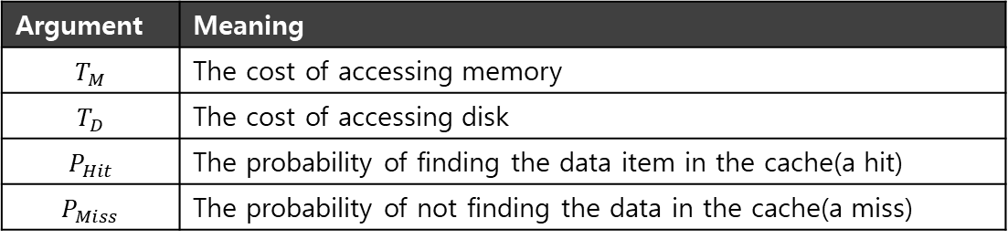

Cache Management
Goal in picking a replacement policy for this cache is to minimize the number of cache misses.
The number of cache hits and misses let us calculate the average memory access time (AMAT).
$$AMAT=\left(P_{Hit}∗T_{M}\right)+(P_{Miss}∗T_{D})$$
Argument | Meaning
$$T_{M}$$ | The cost of accessing memory
$$T_{D}$$ | The cost of accessing disk
$$P_{Hit}$$ | The probability of finding the data item in the cache(a hit)
$$P_{Miss}$$ | The probability of not finding the data in the cache(a miss)

Slide 60
The Optimal Replacement Policy
Leads to the fewest number of misses overall
Replaces the page that will be accessed furthest in the future
Resulting in the fewest-possible cache misses
Could we realize the Optimal Replacement Policy?

Slide 61
The Optimal Replacement Policy
Leads to the fewest number of misses overall
Replaces the page that will be accessed furthest in the future
Resulting in the fewest-possible cache misses
Could we realize the Optimal Replacement Policy?
No, serves only as a comparison point (benchmark), to know how close we are to perfect.

Slide 62

Tracing the Optimal Policy
Reference Row
0
1
2
0
1
3
0
3
1
2
1
Access | Hit/Miss? | Evict | Resulting Cache State
0 | Miss |  | 0
1 | Miss |  | 0,1
2 | Miss |  | 0,1,2
0 | Hit |  | 0,1,2
1 | Hit |  | 0,1,2
3 | Miss | 2 | 0,1,3
0 | Hit |  | 0,1,3
3 | Hit |  | 0,1,3
1 | Hit |  | 0,1,3
2 | Miss | 3 | 0,1,2
1 | Hit |  | 0,1,2
Hit rate is $\frac{Hits}{Hits+Misses}=54.6\%$
Future is not known.

Slide 63
A Simple Policy: FIFO
Pages were placed in a queue when they enter the system.
When a replacement occurs, the page on the tail of the queue (the “First-in” pages) is evicted.
It is simple to implement, but can’t determine the importance.

Slide 64

Tracing the FIFO Policy
Reference Row
0
1
2
0
1
3
0
3
1
2
1
Access | Hit/Miss? | Evict | Resulting Cache State
0 | Miss |  | 0
1 | Miss |  | 0,1
2 | Miss |  | 0,1,2
0 | Hit |  | 0,1,2
1 | Hit |  | 0,1,2
3 | Miss | 0 | 1,2,3
0 | Miss | 1 | 2,3,0
3 | Hit |  | 2,3,0
1 | Miss |  | 3,0,1
2 | Miss | 3 | 0,1,2
1 | Hit |  | 0,1,2
Hit rate is $\frac{Hits}{Hits+Misses}=36.4\%$
Even though page 0 had been accessed a number of times, FIFO still kicks it out.

Slide 65
BELADY’S ANOMALY
We would expect the cache hit rate to increase when the cache gets larger. But in this case, with FIFO, it gets worse.
Reference Row
1
2
3
4
1
2
5
1
2
3
4
5

Slide 66
Another Simple Policy: Random
Picks a random page to replace under memory pressure.
It doesn’t really try to be too intelligent in picking which blocks to evict.
Performance depends entirely upon how lucky Random gets in its choice.
Access | Hit/Miss? | Evict | Resulting Cache State
0 | Miss |  | 0
1 | Miss |  | 0,1
2 | Miss |  | 0,1,2
0 | Hit |  | 0,1,2
1 | Hit |  | 0,1,2
3 | Miss | 0 | 1,2,3
0 | Miss | 1 | 2,3,0
3 | Hit |  | 2,3,0
1 | Miss | 3 | 2,0,1
2 | Hit |  | 2,0,1
1 | Hit |  | 2,0,1

Slide 67
Random Performance
Sometimes, Random is as good as optimal, achieving 6 hits on the example trace.
Random Performance over 10,000 Trials

Slide 68
Using History
Lean on the past and use history.
Two type of historical information.
Historical Information | Meaning | Algorithms
recency | The more recently a page has been accessed, the more likely it will be accessed again | LRU
frequency | If a page has been accessed many times, It should not be replaced as it clearly has some value | LFU

Slide 69
Using History: LRU
Reference Row
Replaces the least-recently-used page.
0
1
2
0
1
3
0
3
1
2
1
Access | Hit/Miss? | Evict | Resulting Cache State
0 | Miss |  | 0
1 | Miss |  | 0,1
2 | Miss |  | 0,1,2
0 | Hit |  | 1,2,0
1 | Hit |  | 2,0,1
3 | Miss | 2 | 0,1,3
0 | Hit |  | 1,3,0
3 | Hit |  | 1,0,3
1 | Hit |  | 0,3,1
2 | Miss | 0 | 3,1,2
1 | Hit |  | 3,2,1

Slide 70
Workload Example : The No-Locality Workload
Each reference is to a random page within the set of accessed pages.
Workload accesses 100 unique pages over time.
Choosing the next page to refer to at random
The No-Locality Workload
100%
80%
When the cache is large enough to fit the entire workload,
it also doesn’t matter which policy you use.
60%
Hit Rate
OPT
LRU
40%
FIFO
RAND
20%
20
40
60
80
100
Cache Size (Blocks)

Slide 71
Workload Example: The 80-20 Workload
Exhibits locality: 80% of the reference are made to 20% of the page
The remaining 20% of the reference are made to the remaining 80% of the pages.
The 80-20 Workload
100%
80%
LRU is more likely to
hold onto the hot pages.
60%
Hit Rate
OPT
LRU
40%
FIFO
RAND
20%
20
40
60
80
100
Cache Size (Blocks)

Slide 72
Workload Example: The Looping Sequential
Refer to 50 pages in sequence.
Starting at 0, then 1, … up to page 49, and then we Loop, repeating those accesses, for total of 10,000 accesses to 50 unique pages.
The Looping-Sequential Workload
100%
80%
60%
Hit Rate
OPT
LRU
40%
FIFO
RAND
20%
20
40
60
80
100
Cache Size (Blocks)

Slide 73
Implementing Historical Algorithms
To keep track of which pages have been least-and-recently used, the system has to do some accounting work on every memory reference.
Add a little bit of hardware support.

Slide 74
Approximating LRU
Require some hardware support, in the form of a use bit
Whenever a page is referenced, the use bit is set by hardware to 1.
Hardware never clears the bit, though; that is the responsibility of the OS
Clock Algorithm
All pages of the system arranges in a circular list.
A clock hand points to some particular page to begin with.

Slide 75
Clock Algorithm
The algorithm continues until it finds a use bit that is set to 0.
A
H
B
Use bit | Meaning
0 | Evict the page
1 | Clear Use bit and advance hand
G
C
F
D
E
The Clock page replacement algorithm
When a page fault occurs, the page the hand is pointing to is inspected. The action taken depends on the Use bit

Slide 76
Workload with Clock Algorithm
Clock algorithm doesn’t do as well as perfect LRU, it does better then approach that don’t consider history at all.
The 80-20 Workload
100%
80%
60%
Hit Rate
OPT
LRU
40%
Clock
FIFO
RAND
20%
20
40
60
80
100
Cache Size (Blocks)

Slide 77
Considering Dirty Pages
The hardware include a modified bit (a.k.a dirty bit)
Page has been modified and is thus dirty, it must be written back to disk to evict it.
Page has not been modified, the eviction is free.

Slide 78
Page Selection Policy
The OS has to decide when to bring a page into memory.
Presents the OS with some different options.

Slide 79
Prefetching
The OS guess that a page is about to be used, and thus bring it in ahead of time.
Page 1 is brought into memory
Page 3
Page 4
Page 5
…
Page n
Physical Memory
Page 2
…
Page 1
Page 3
Page 4
Secondary
Storage
Page 2 likely soon be accessed and
thus should be brought into memory too

Slide 80
Clustering, Grouping
Collect a number of pending writes together in memory and write them to disk in one write.
Perform a single large write more efficiently than many small ones.
Pending writes
Page 1
Page 2
Page 3
Page 4
Page 5
…
Page n
Physical Memory
write in one write
Page 2
…
Page 1
Page 3
Page 4
Secondary
Storage

Slide 81
Thrashing
Memory is oversubscribed and the memory demands of the set of running processes exceeds the available physical memory.
Decide not to run a subset of processes.
Reduced set of processes working sets fit in memory.
CPU
Utilization
Trashing
Degree of multiprogramming

